Slide 1
Scenario 10
To log all delete operation on a file

Slide 2
Reason for creating logs externally:
Logs for delete operations are not directly stored inside the /var/logs folder in linux
The OS creates the logs temporarily while the delete operation is on the go but the logs are discarded as soon as the delete operations are completed.
This is primarily done to reduce the redundancy of data i.e. the OS doesn’t presser to keep data of files or folders that no longer exist on it’s system

Slide 3
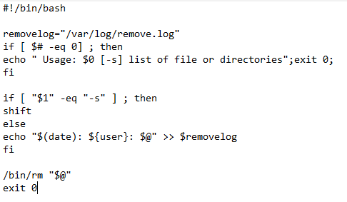
Original Shell file from facilitator’s guide:
Slide 11 : $#, $@......
Slide 12 : date command
Slide 15:c++ analogy
See slide notes for all slides
Notes:
This is the original solution to the scenario(given in the falicitators guide):
This is a program of a command line input via shell scripting where the program calling/execution would look something like:
./program.sh f1 f2 f3 f4
Or
./program.sh –s f1 f2 f3 f4
Where f1 f2 f3…… or –s are command line inputs
(NOTE: The program specifies that if a user also give –s as an input the logs must not be created….. Something like a switch case program where if switch matches the input do or not do something)
The removelog variable stores the address/ location of the file that stores the file that stores the logs
$# stores the number of argument in the command line(./program.sh f1 f2 f3 f4 has 5 arguments and ./program.sh –s f1 f2 f3 f4 has 6 agruments)
The if clause specifically checks for the –s condition, which if exists , causes only deletion and no generation of logs which would have been generated in the else section. The “shift” operation just shifts the index of each argument by 1 i.e. #0 becomes #1 and so on.
$@ specifies all the arguments satring from #1
The second last line of program causes deletion(ultimate aim of program)

Slide 4
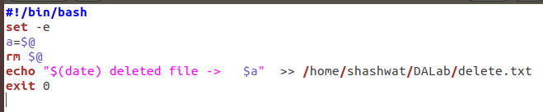
Simplified shell file
Notes:
This program is a much more simplified version of the previous code, just here we focus on deletion and log generation without any other condition to keep in mind.

Slide 5
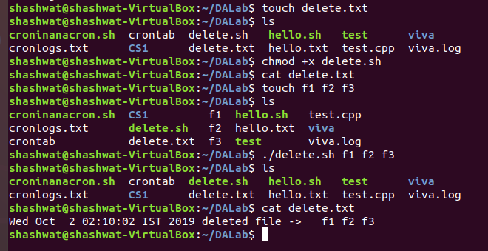
Execution of shell file:
Notes:
This shows the execution of the shell script

Slide 6
Limitations of this method:
This is not an actual command but a shell script running via command line arguments
This would not help us to delete any files that are inside any other directory, neither in it’s parent or child directory

Slide 7
Creation of Linux custom commands:
We can create custom linux commands to perform specific operations in linux
This is done inside the .bashrc file where the command is implemented in form of functions
Notes:
The original method is very vague and not corresponding of using the power of linux terminal.
Therefore, a better solution for the problem would be to create our very own custom linux commands and use them thereafter.
All command are created using .bashrc file simply because this is the file that would be loaded first when the terminal opens, therefore any file in any directory could be deleted and its logs be generated, which wasn’t possible with the previous solution.
This works something like the pre-processor directive of the c or c++ program, where the #define would plunge all the header files into the program before any other compilation or execution, therefore making all functions and processes available throughout the entire program.

Slide 8
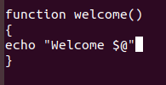
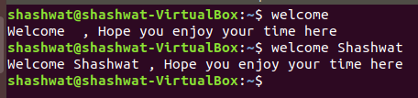
Example of custom command:
Notes:
The picture states the way to create our own custom linux commands.
Just open .bashrc file(via nano .bashrc) and type in the program just like a function where the function name being the name of the command.

Slide 9
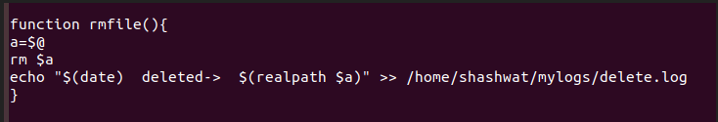
Creating custom rmfile command:
Notes:
This is the command for deletion of files written in .bashrc file

Slide 10
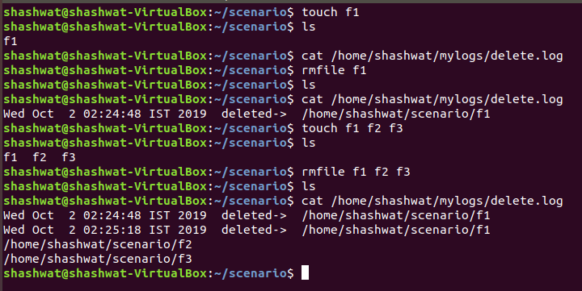
Execution of the custom command:

Slide 11
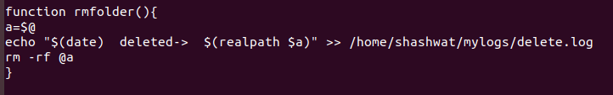
A similar custom command:
Notes:
A similar command could be written for deleting folders as well

Slide 12
THE END

Slide 13

Extra(command line argument in shell file):
$# : gives the count of the number of strings as command line input
$@ : stores the complete string given as command line input
$1,$2,…… : denotes the string at position 1 and 2 and so on in the command line input
Slide 2: GO back
Notes:
Reference slide 1

Slide 14
date command formats:
%D: Display date as mm/dd/yy.
%d: Display the day of the month (01 to 31).
%a: Displays the abbreviated name for weekdays (Sun to Sat).
%A: Displays full weekdays (Sunday to Saturday).
%h: Displays abbreviated month name (Jan to Dec).
%b: Displays abbreviated month name (Jan to Dec).
%B: Displays full month name(January to December).
%m: Displays the month of year (01 to 12).
%y: Displays last two digits of the year(00 to 99).
%Y: Display four-digit year.
%T: Display the time in 24 hour format as HH:MM:SS.
%H: Display the hour.
%M: Display the minute.
%S: Display the seconds.
Slide 2: GO back
Notes:
Reference slide 2

Slide 15
#include<iostream>
using namespace std;
int main(int argv,char* argc)
{
if(argv == 0)
{
cout<<"This is not the correct usage of the program"<<endl;
exit(1);
}
if(argc[1]=='-s')
{
delete_all_files(2); //deletes all files present from index number 2 to n
}
else
{
create_logs(); //function to create logs
delete_all_files(1); //deletes all files present from index number 1 to n
}
}
./main -s f1 f2 f3
./main f1 f2 f3
Slide 3: go back

